Slide 1
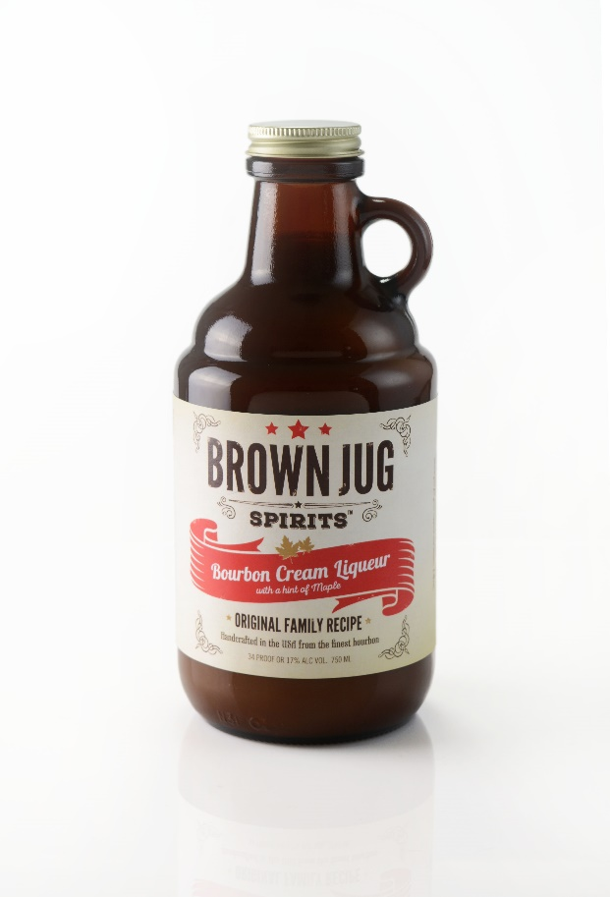
Brown Jug Bourbon Cream
Bourbon Cream with a hint of Maple made with the best Bourbon and the finest dairy cream
Made in Michigan and American owned
Americana inspired honest, hardworking with a dash of fun all wrapped up in a brilliant American libation
Consumer: 60% female / 40% male
Enjoy frozen or with coffee in drinks such as Bourbon Milkshake, Bourbon Root Beer Float and Awesome American Coffee
More recipes can be found at brownjugspirits.com
Available in 750ml

