Slide 1
BRUSCO, RECIO MEZCAL
Our integrated methods
Bruno M. García - C.E.O.
Yakin A. Oggier - C.O.O.
Matatena Spirits, S.A.
Privada Hipódromo 1997, GDL.
info@materiaglobal.com

Slide 2
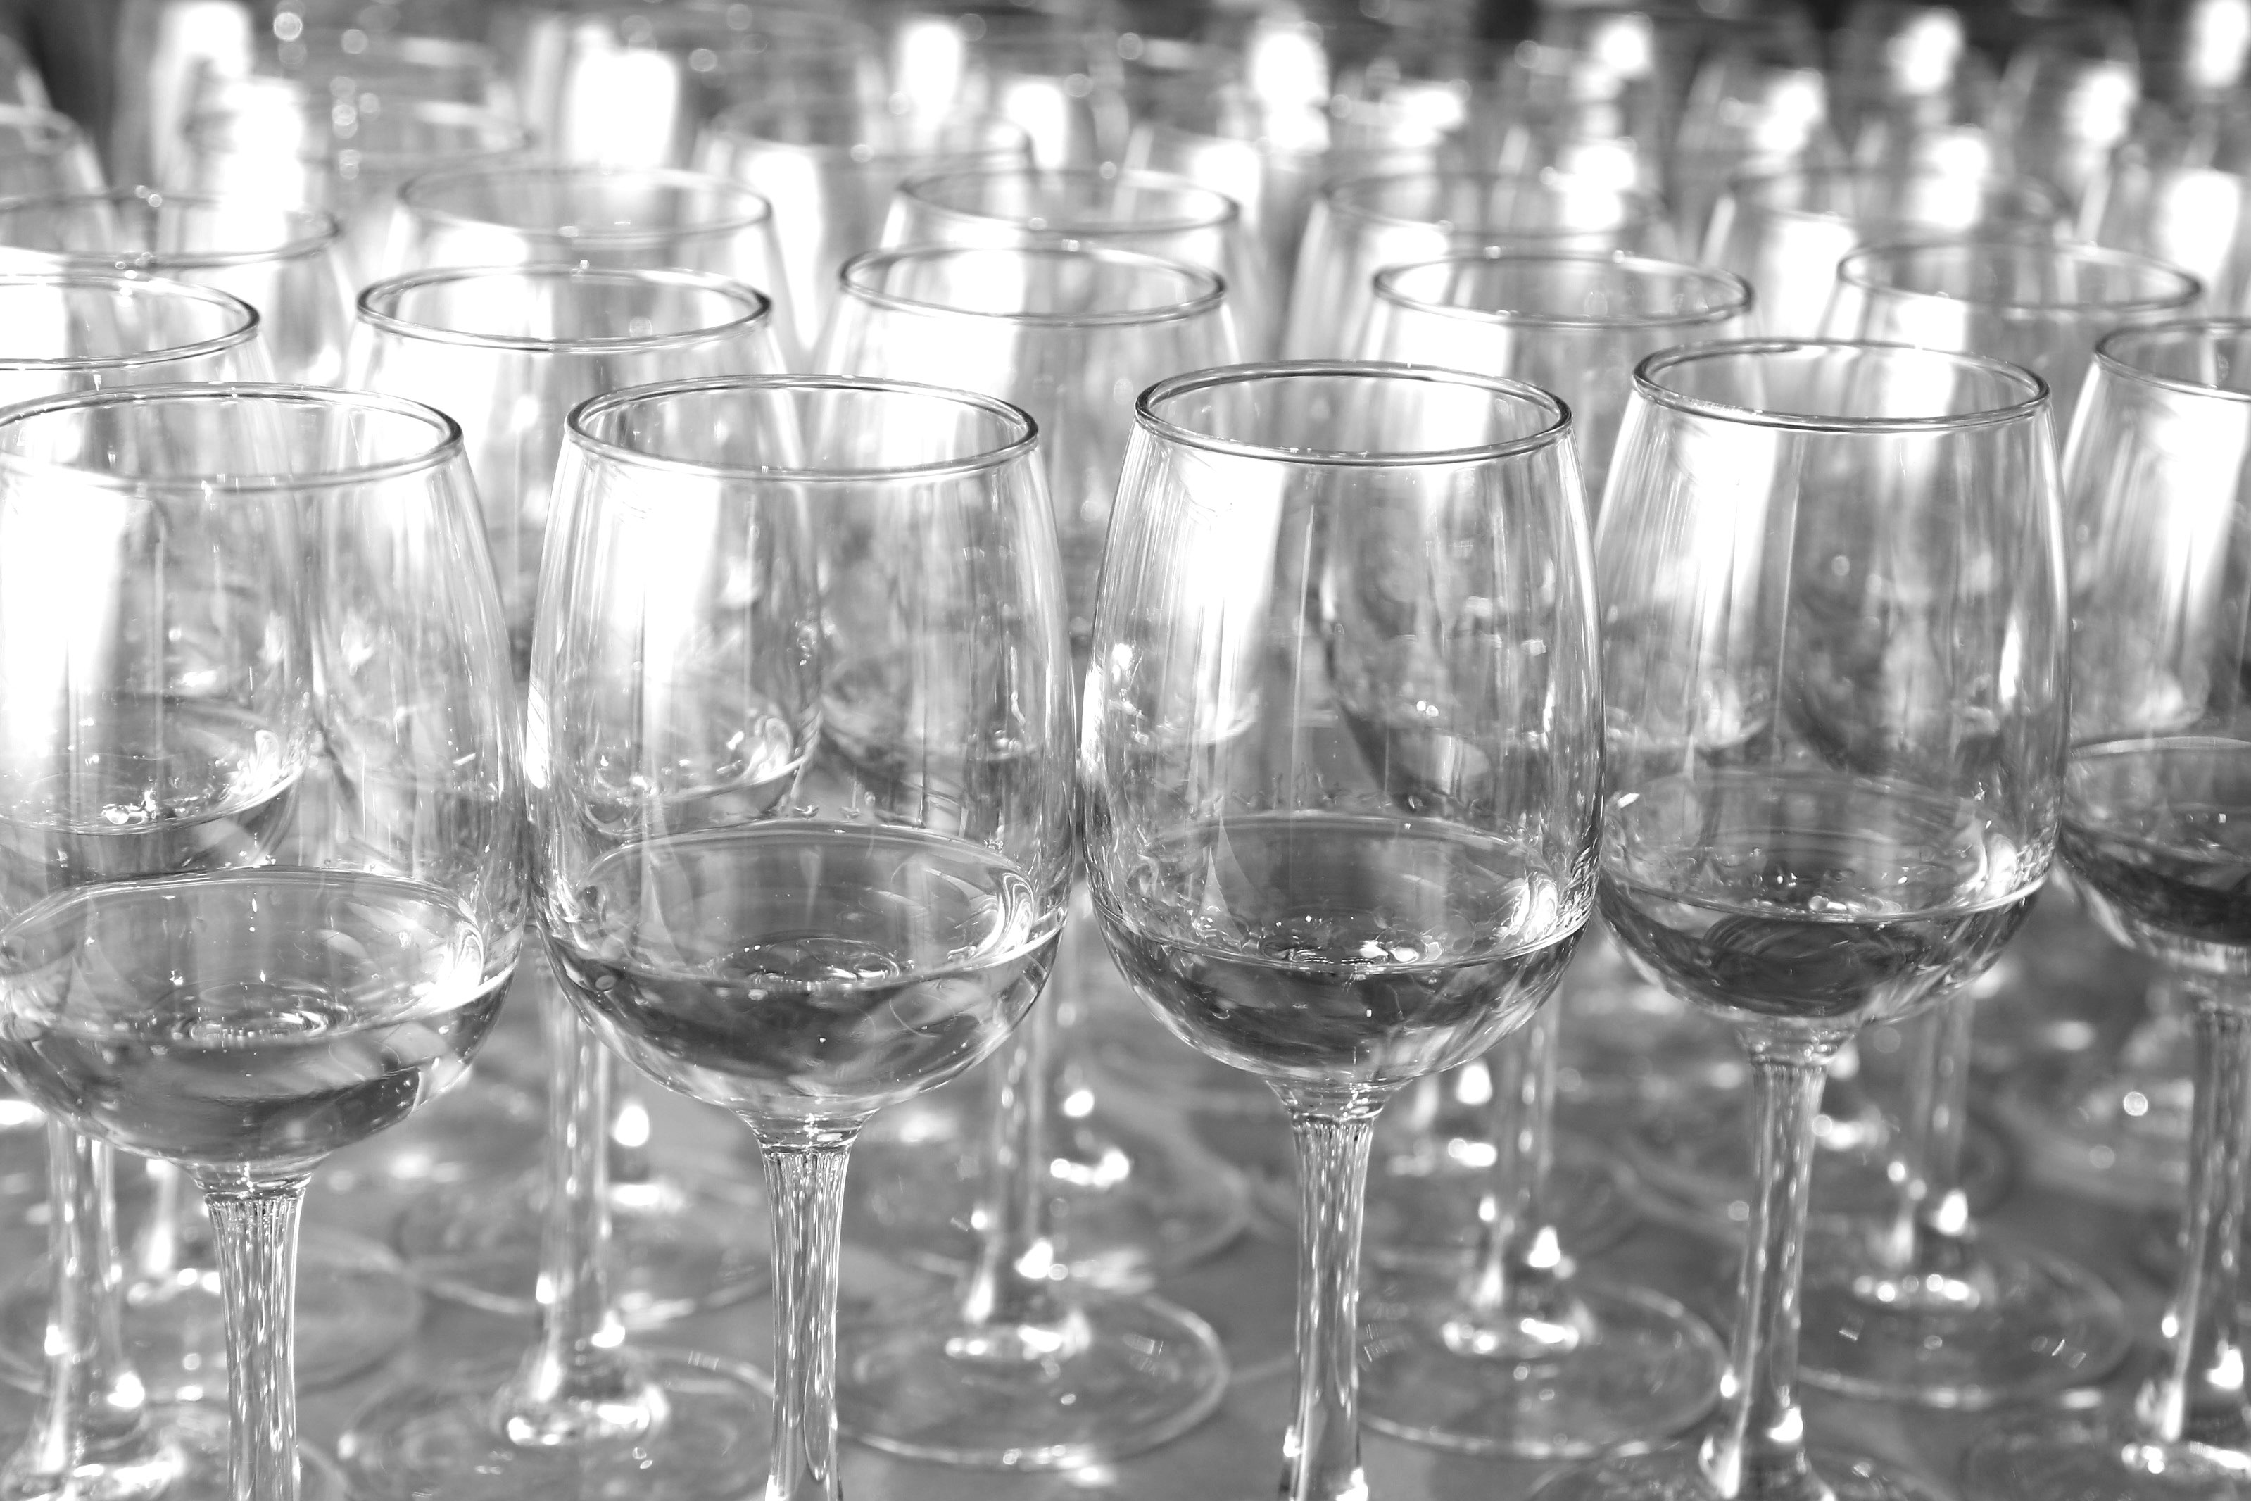

Slide 3
AGENDA
Brusco, recio Mezcal
Production
Agave System & Expressions
Espadín: Cultivated
Sierra Negra: Semi-cultivated
Tobasiche: Wild
BRUSCO MEZCAL, HOW WE MAKE IT
BRUSCO MEZCAL, HOW WE MAKE IT

Slide 4
BRUSCO
Setting grounds - Mezcal is certainly the mother of all agave spirits and, by essence, one of the most complex around the globe, due to its variety of raw material (agave), regions of production and processes.
Brusco Premium Mezcal is driven by artisanal and traditional methods, but more specifically Brusco arises under three mezcal expressions as an outcome of the local Community’s agricultural vision:
Espadin, cultivated.
Sierra Negra, semi-cultivated.
Tobasiche, wild.
BRUSCO MEZCAL, HOW WE MAKE IT

Slide 5
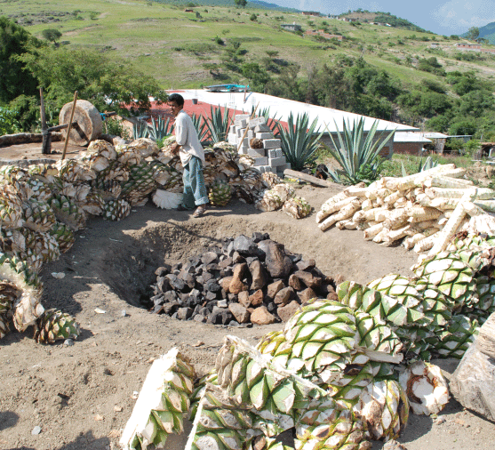
PRODUCTION
DISTILLERY - NOM-O509X
MATERIA PRIMA SPIRITS, SA DE CV
FACILITIES - ‘PALENQUES’
San Baltazar Guelavila, Oaxaca.
Sola de Vega, Oaxaca.
METHODS - ARTISANAL
Ripe agaves picked by hand under a three-layered cultivation system are cooked (in separate batches) in conic ground ovens, the mosto (juice) is extracted from the pulp by tahona (stone wheel) and then fermented in wood vats for about 4-8 days; the juice is distilled in copper or clay pots, depending the palenque (distillery) and expression of mezcal.
AGAVES - SYSTEM
Espadin, cultivated.
Sierra Negra, semi-cultivated.
Tobasiche, wild.
BRUSCO MEZCAL, HOW WE MAKE IT

Slide 6
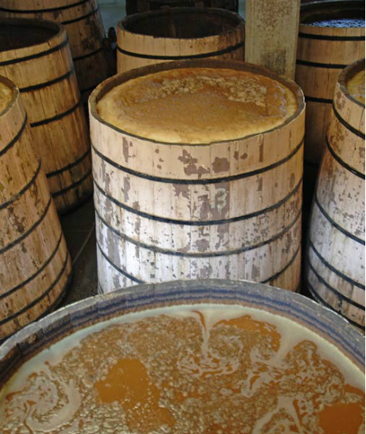
PRODUCTION
DISTILLERY - NOM-O509X
MATERIA PRIMA SPIRITS, SA DE CV
FACILITIES - ‘PALENQUES’
San Baltazar Guelavila, Oaxaca.
Sola de Vega, Oaxaca.
METHODS - ARTISANAL
Ripe agaves picked by hand under a three-layered cultivation system are cooked (in separate batches) in conic ground ovens, the mosto (juice) is extracted from the pulp by tahona (stone wheel) and then fermented in wood vats for about 4-8 days; the juice is distilled in copper or clay pots, depending the palenque (distillery) and expression of mezcal.
AGAVES - SYSTEM
Espadin, cultivated.
Sierra Negra, semi-cultivated.
Tobasiche, wild.
BRUSCO MEZCAL, HOW WE MAKE IT

Slide 7
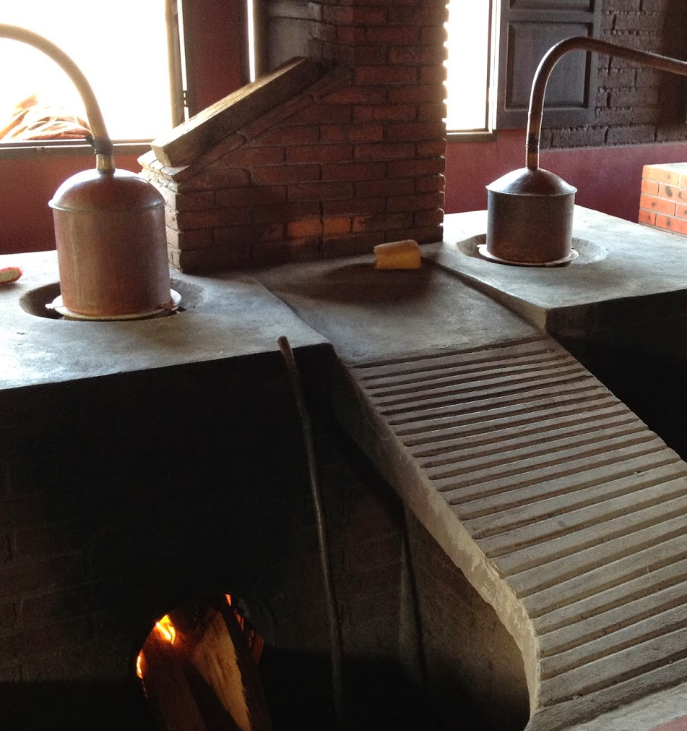
PRODUCTION
DISTILLERY - NOM-O509X
MATERIA PRIMA SPIRITS, SA DE CV
FACILITIES - ‘PALENQUES’
San Baltazar Guelavila, Oaxaca.
Sola de Vega, Oaxaca.
METHODS - ARTISANAL
Ripe agaves picked by hand under a three-layered cultivation system are cooked (in separate batches) in conic ground ovens, the mosto (juice) is extracted from the pulp by tahona (stone wheel) and then fermented in wood vats for about 4-8 days; the juice is distilled in copper or clay pots, depending the palenque (distillery) and expression of mezcal.
AGAVES - SYSTEM
Espadin, cultivated.
Sierra Negra, semi-cultivated.
Tobasiche, wild.
BRUSCO MEZCAL, HOW WE MAKE IT

Slide 8
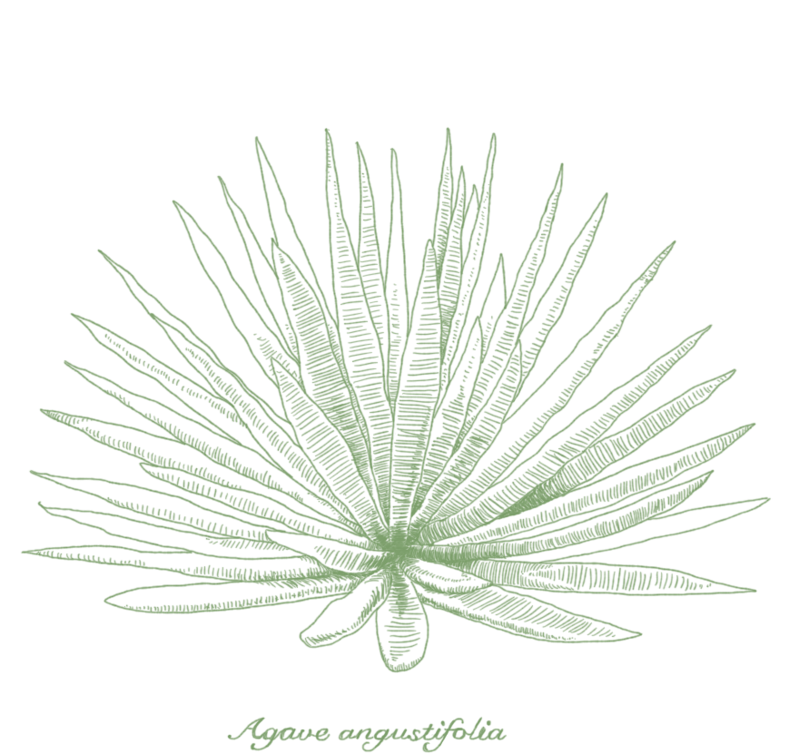
AGAVE SYSTEM
ESPADÍN - ANGUSTIFOLIA HAW
Espadin is the most common and widely preferred agave for the making of mezcal, due to its sugar yields, wide distribution and sophisticated flavor.
COMMUNITY
San Baltazar Guelavila, Oaxaca.
Composed mainly by indigenous families.
METHOD - CULTIVATED
Our cultivation and farming methods avoid all use of pesticides, fertilizers and herbicides. Our cultivated espadin, grows in the Central Valleys of Oaxaca under the surveillance of Felix and Joel Velasco a 4th generation family of agave growers which manually pick the agaves which meet standards of matureness at sight, weight and health.
ESPADÍN, ANGUSTIFOLIA HAW

Slide 9
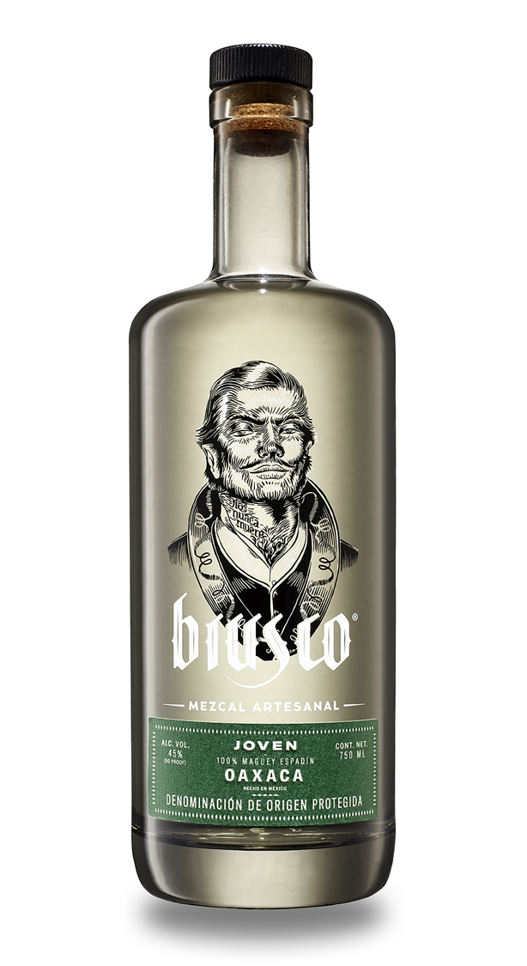
1st EXPRESSION
45 ABV (90 Proof)
CONTENT - 750 mL
BOTTLE - 29.4 / 7.67 cms
CASE - 26.5/17.7/28 cms
Pallet with 92 cases
Artisanal methods are applied to enrich the cultural heritage and the finished product, our Brusco Espadín is cooked in ground ovens along with oak coal, which will add a complex layer of flavors and aromas such as smoke, ash and soil.
Shredded with tahona, fermented in wooden vats with natural yeasts and double distilled with copper pot stills.
Agave species - Angustifolia Haw
Farming method - Cultivated Agave
Region - Soledad Salinas, Oaxaca.
Distillery Location - San Baltazar
Maestro Mezcalero - Lucio Bautista & Joel Velasco
Harvest - 6-8 years
Cooking - Conic ground ovens fired with (dead) oak coal
Shredding - Tahona (stone wheel).
Fermentation - natural in wood vats.
Distillation: double in copper pot stills.
ESPADÍN, ANGUSTIFOLIA HAW

Slide 10
THANK YOU
Please, visit materiaglobal.com
Bruno M. García - C.E.O.
Yakin A. Oggier - C.O.O.
Materia Prima Spirits, S.A.
Privada Hipódromo 1997, GDL.
info@materiaglobal.com

