Slide 1
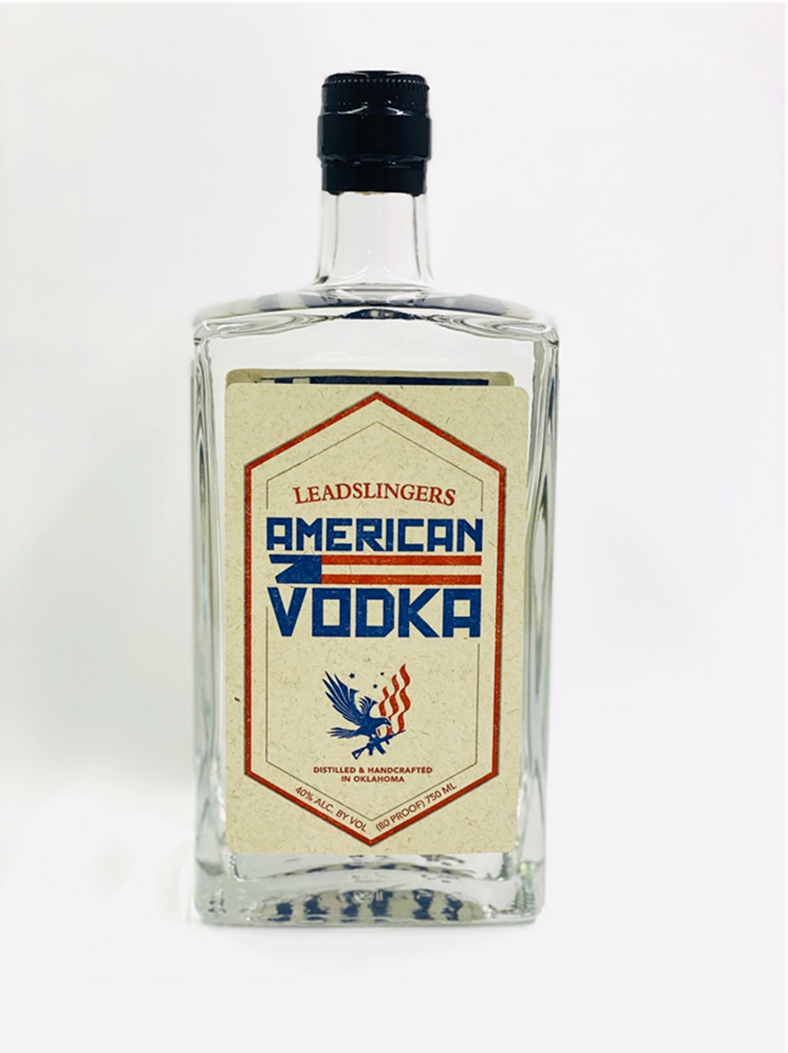
Leadslingers Vodka
Leadslingers Vodka is distilled using a 6x plate continuous still distillation process
100% Red Winter Wheat, 80 proof
Leadslingers uses activated carbon made from crushed coconut shells for the neutralization process
Veteran owned, American made, Leadslingers has become a force to be reckoned with

