Slide 1
Stoller Imports Now Representing Lorenzo Inga brands from Italy

Slide 2
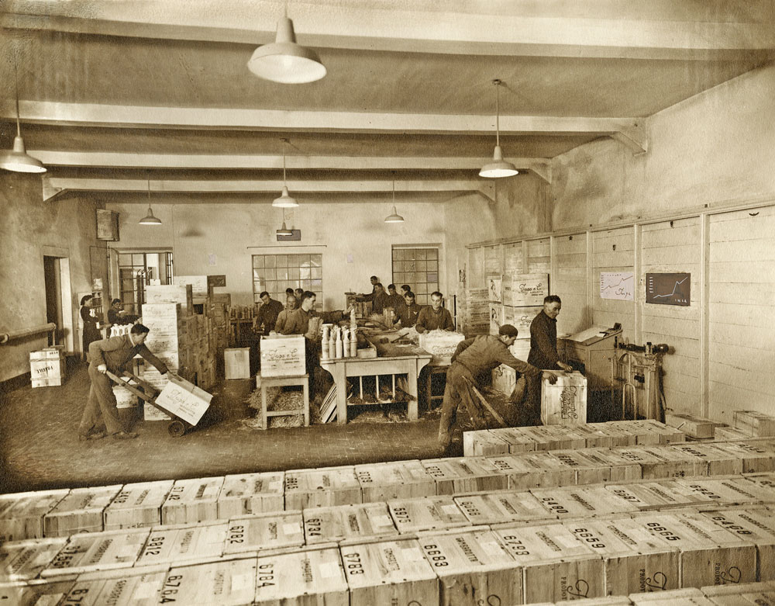
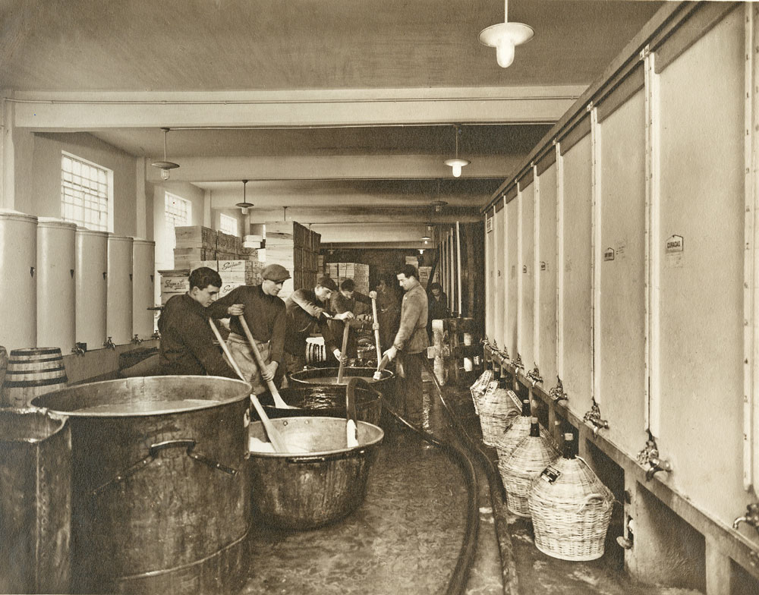
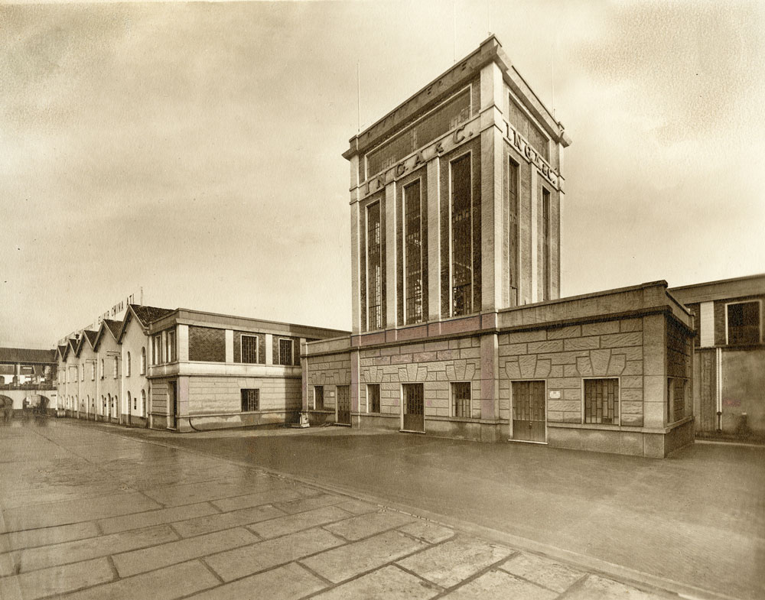
The Inga family produce distilled spirits and liqueurs of premium quality since 4 generations although 1832 is the date of our foundation and related to an old herb's elixir recipe created by a capucine monk. The founder of the company was the great grandfather of the current owners, Gaetano Inga from Noto, Sicily where in 1900 was producing locally brandy and Marsala wine: in 1920 he decided to move to Piedmont in the village of Serravalle Scrivia where he built up a distillery. After the end of II° World War, Elio Inga, the nephew, entered the company very young and strongly pushed the brands Inga & amp; Gambarotta till 1966 when he decided to invent a new way of distilling grappa keeping flavors and perfumes, so far much different from the rustic and strong grappa produced locally and giving the brand name of Grappa Libarna, very successful in the 70/80’ and whose brand being sold in 1983. Presently, Lorenzo & amp; Federico Inga, Elio’s sons are taking care of the company and carrying the business and the tradition of the Inga family, producing premium spirits such as varietal grappas, liqueurs, cordials, aperitives with popular brands as Lorenzo Inga Selection, My Grappa, Gran Milano, Maestro Café and launching in 2016 Panarea Gin, a premium distilled Italian gin typically Mediterranean, a really lifestyle brand gaining high consensus and positive feedback domestically and internationally.

Slide 3
Lorenzo Inga Grappa's
Numerous distilleries from Italy can refer to a company history that began as early as the 19th century. So is Lorenzo Inga. The roots of the famous family distillery founded by Gaetano Inga from the wine stronghold of Piedmont, which originally bore the name Gambarotti, date back to 1832. The cradle of the company, which is now in its fifth generation, was in Noto, Sicily. At that time, the classic Campari was not yet invented and cities such as Turin and Milan gradually moved into the limelight as locations for major spirits producers. Today Lorenzo Inga Jr. can benefit from the great experience and competence of many ancestors. Top winegrowers from Northern Italy are always reliable suppliers for the pure grappa made from Moscato, Dolcetto, Barbera and Nebbiolo.

Slide 4
Lorenzo Inga “My” Liqueurs
Lorenzo Inga Selection My Sambuca is a delicious anis liqueur made with 100% natural ingredients including star anis distillate and a touch of liquorice and chocolate distilled extracts
Limoncello. Ah yes. Friend of trifles. Delish. This one is made with Sicilian lemons. This liqueur has its roots in Sicily and is transmitted from generation to generation since 1832. The bottle bears the name of Lorenzo Inga, which develops the limoncello with the utmost attention by the original family recipes.
Amaretto from top producer Lorenzo Inga. Made in Gavi, a town famous for its amaretti biscuits, this liqueur also contains Sicilian almond extracts.

Slide 5
Antico Amaro
Our Antico Amaro is an herbal liqueur artisanally produced from an infusion of more than 20 different herbs, plants, roots and tree bark. As a brand, it replaces our My Amaro, which we have sold successfully for a number of years.
The recipe for Antico Amaro dates back to 1832 and was created by a Capuchin monk named Vincislo who had worked on the preparation of his elixir to treat Cholera in India in the 1600s and 1700s. It is a digestif liqueur full of healthy properties due to the various herbs it contains, but it is also a delicious aperitif, drunk on the rocks.
Antico Amaro can be enjoyed on the rocks, with soda, in expresso, and as a base for great cocktails

Slide 6
Gran Milano Bitter
Gran Milano Bitter is a new, original aperitif realized by the Inga Family, different, exotic and full of freshness.
Gran Milano, at 26,2% abv is made by an infusion of herbs and roots such as rosemary, ginger, artemisia, cardamom, gentian and cinchona, fantastic to prepare famous cocktails such as Negroni and Americano!

Slide 7
Panarea Island and Sunset Gin
Panarea Island and Sunset Gins, Italian Gins currently imported into the US from the distinguished House of Inga
Panarea Island Gin Bottling Note
The leading botanicals are juniper, myrtle berries, lemon, orange and coriander, an explosion of perfumes and tastes, a very original product Panarea Island Gin is great on G&T, Negroni, Martini, fashionable cocktails and long drinks; delicious sipped with sushi and raw fish
Panarea Sunset Gin Bottling Note
Inspired by the stunning sunsets that can be seen on the volcanic Panarea Island, this Italian gin was distilled by the Inga family (distillers since 1838) and is full of locally sourced Mediterranean botanicals such as juniper, citrus fruits and basil.
PANAREA ISLAND, SICILY
The Inga family chose the brand “Panarea” as a clear geographical statement of their heritage, as the Inga’s ancestors were Sicilians. The founder of our company, Gaetano Inga, was from Noto, (Syracuse), Sicily.
Panarea is probably the most beautiful island of the whole Aeolian archipelagos, it is a fascinating place with breathtaking views of the active volcano island of Stromboli. The night landscape from Panarea is gorgeous, you can see the lava flowing into the sea...

Slide 8
Maestro Café AUTENTICO LIQUORE ITALIANO ALLA CREMA DI CAFFÉ
We only use the finest and natural ingredients
in our perfect roasted coffee blend and cream
liquor. The coffee beans are from Brazil and all
our authentic ingredients are sourced in Italy,
making it a perfect combination and
balance cream coffee liquor.
Maestro café is to be enjoyed on its
own or to complement and create
the best cocktails and desserts
for your guilty pleasure.

